Slide 1
Css 584 assignment 1 presentation
Jeremy woods

Slide 2
Running the Program
The files have been put into a folder where all that is needed is to execute a bat file.
Wanted the readImage and CBIR files to be ran if the files did not exists.
Had hard time getting them in an executable that could manage that.

Slide 3
Code Used
Used the example code
Changed some index variables in the methods and added some user aspects.

Slide 4
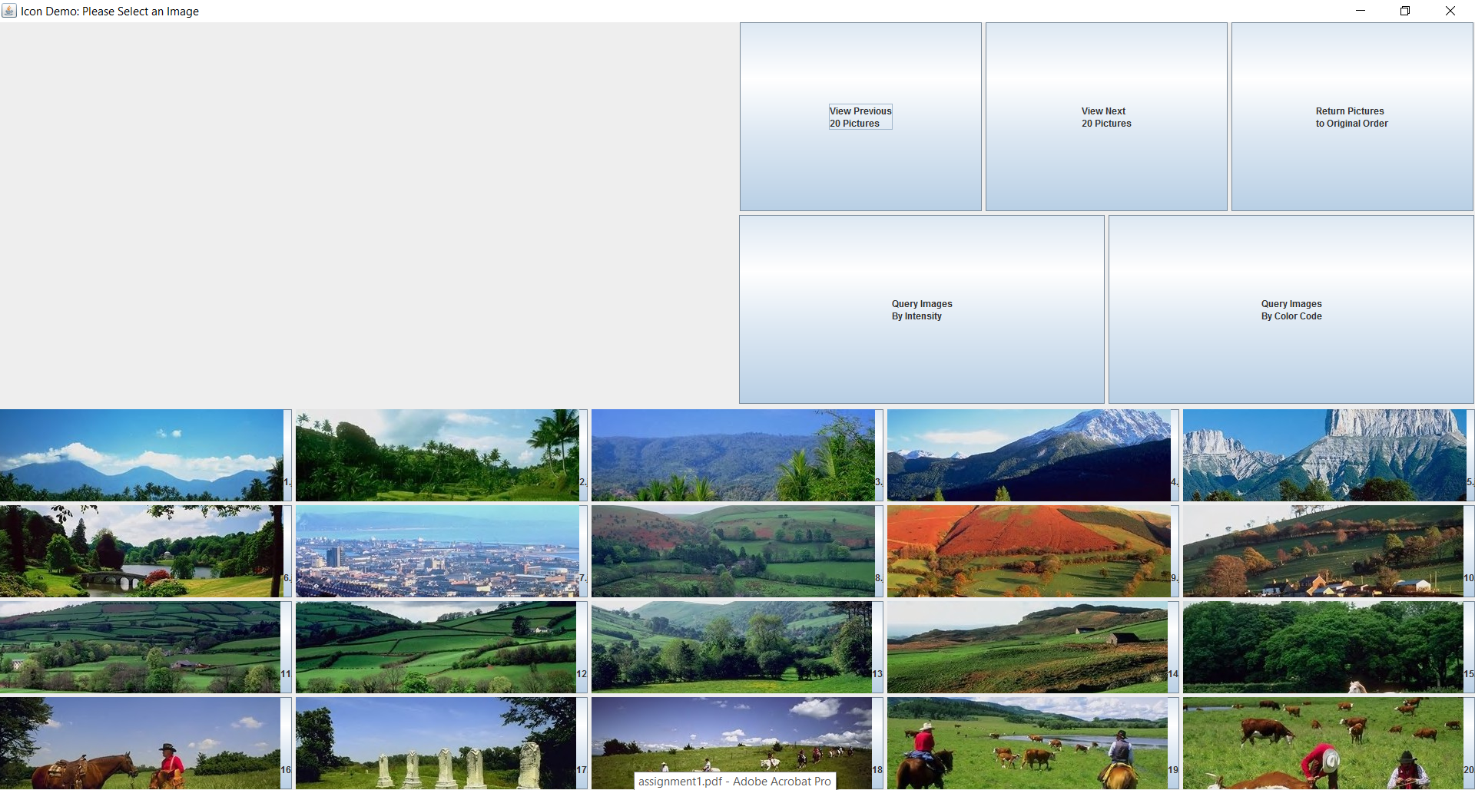

Slide 5
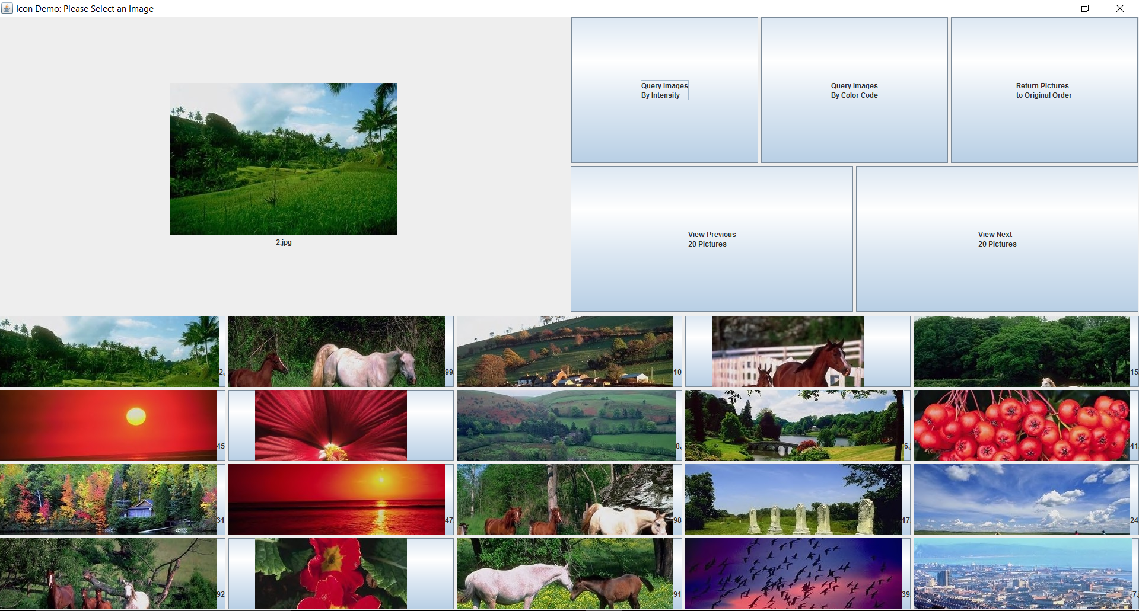

Slide 6
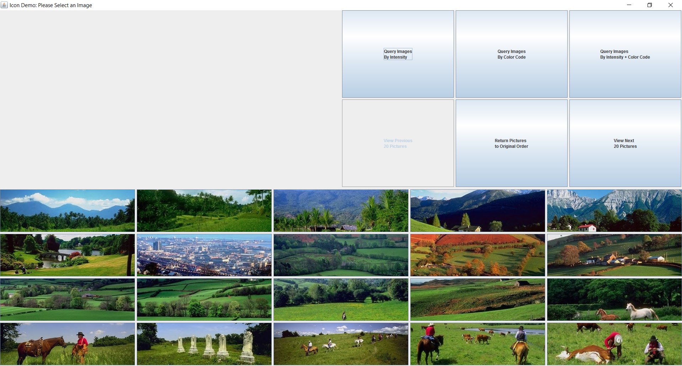

Slide 7
Analysis
Simple Design and implementation
Lots of feed back in the application
Matrices are not aligned, files need to be written and read
No names under pictures, the compare methods are juvenile
Maybe, move to a database?
Use HSV? SIFT or SURF

Slide 8
Thank You Jbw0033@uw.edu

